Slide 1
Cisco Webex Contact Centre
Google TTS Integration
Solution Assurance
October 2020

Slide 2
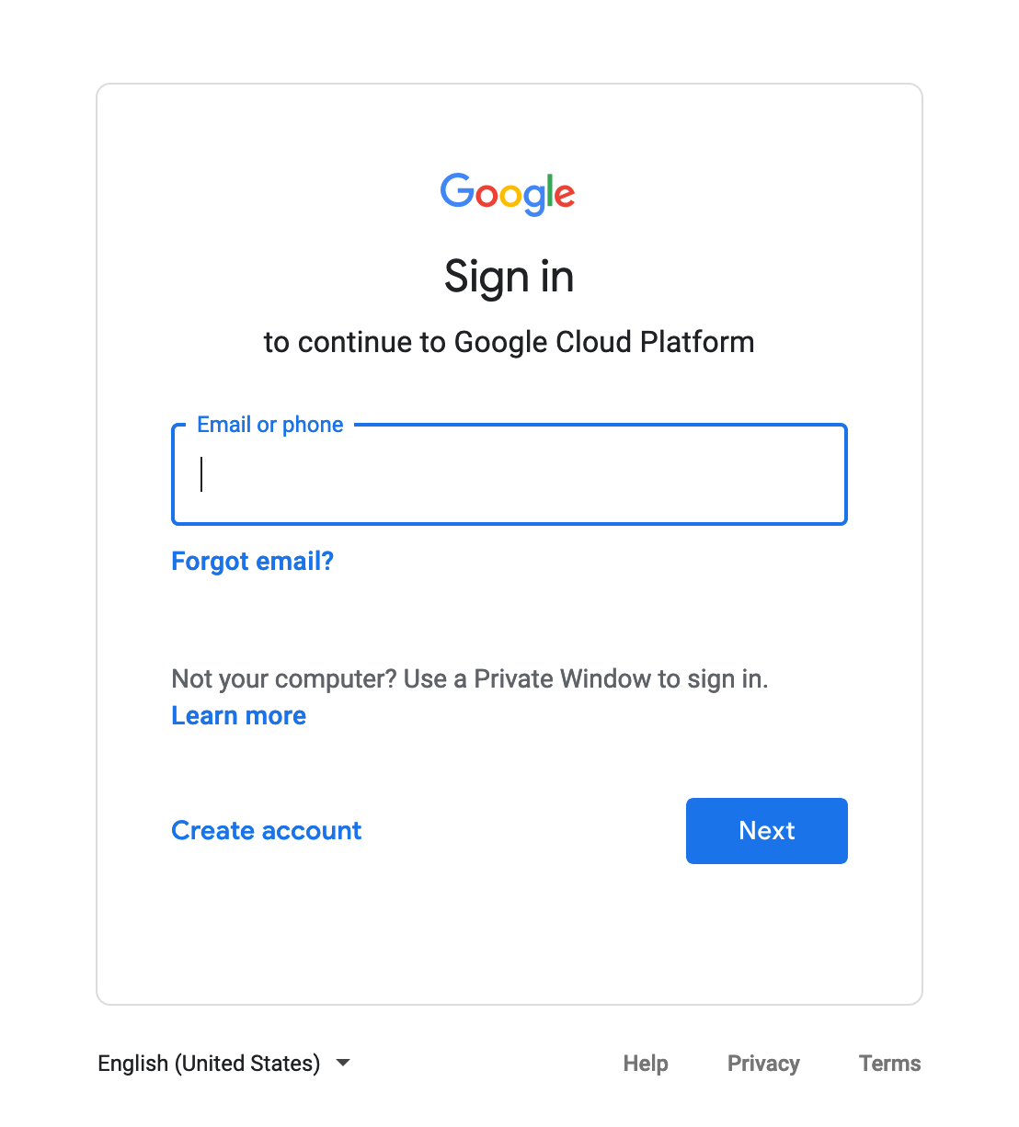
Sign Up with free Google account
https://console.cloud.google.com/

Slide 3
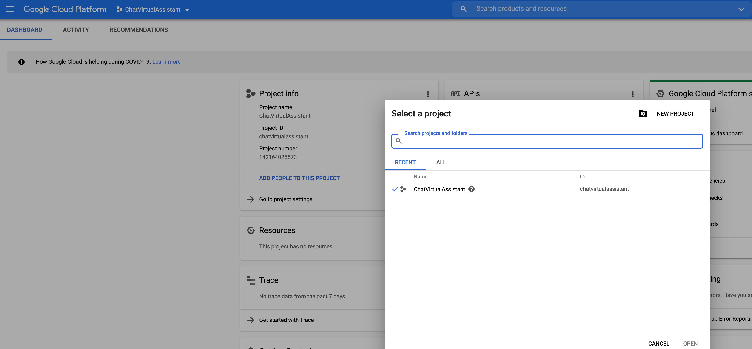
Create a new Project
1
2

Slide 4
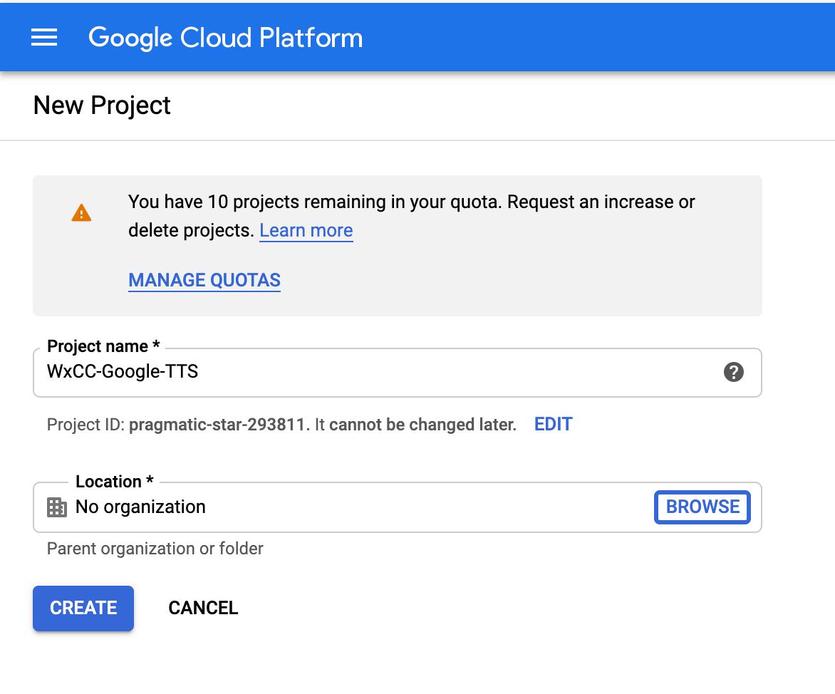
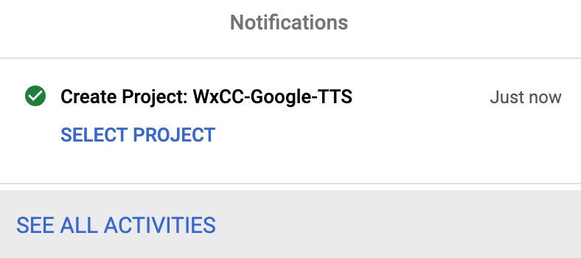
Create a new Project
3
1
2

Slide 5
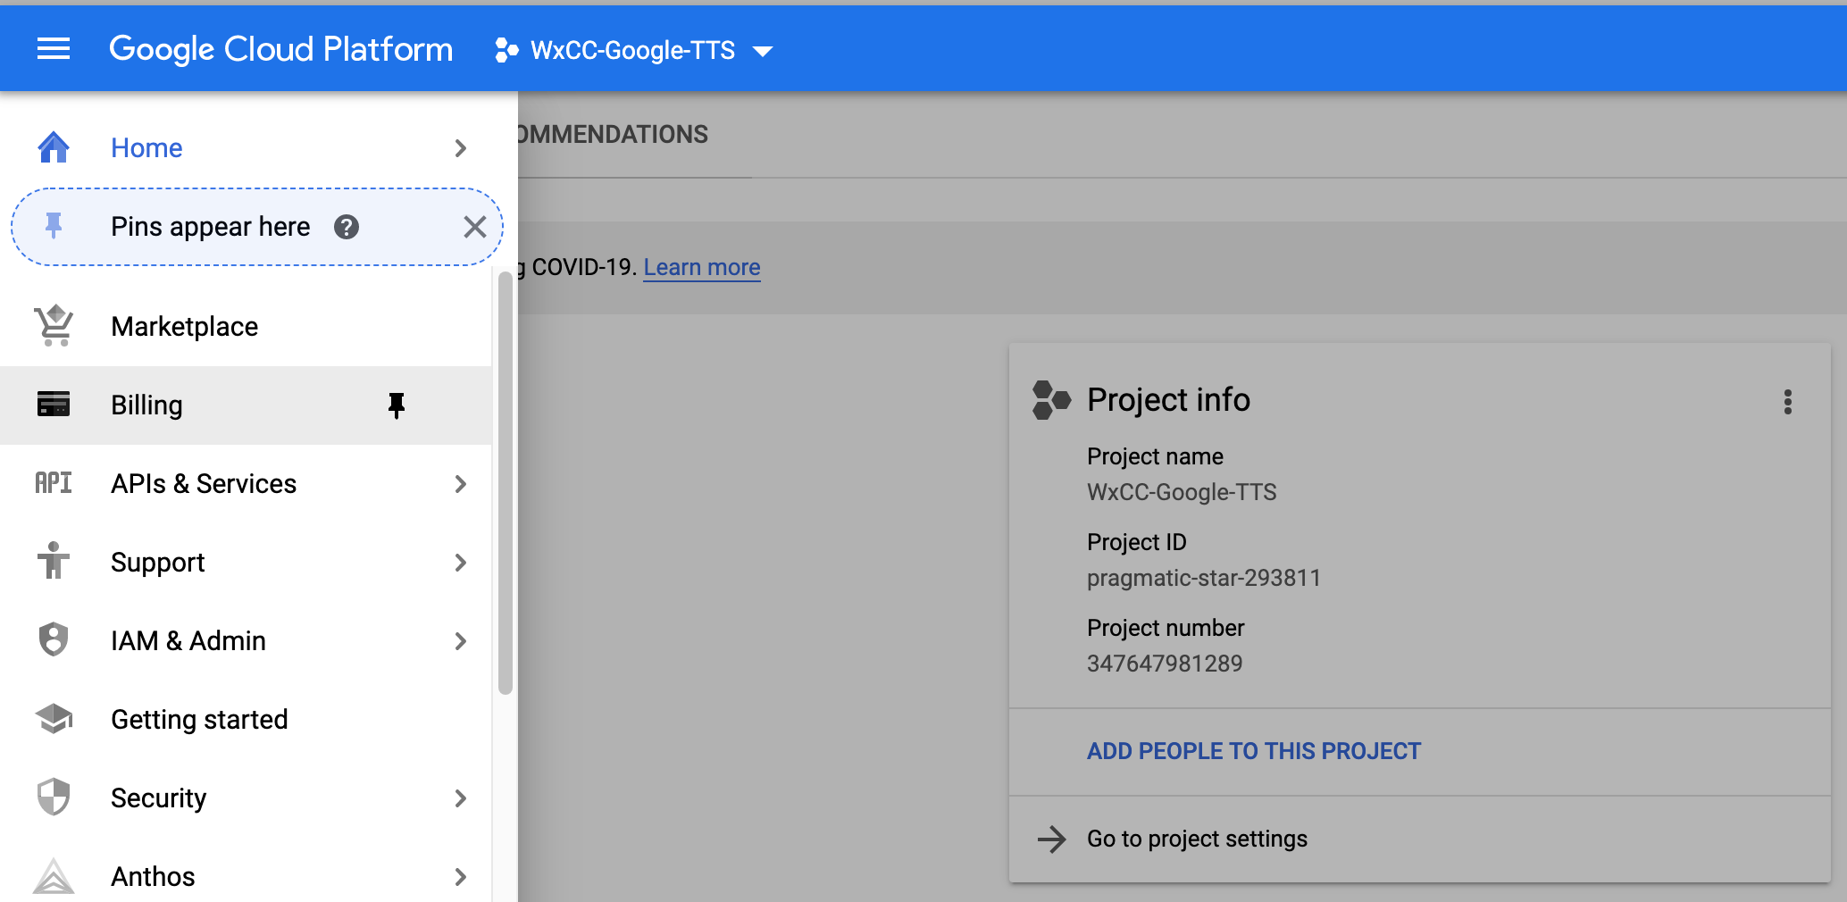
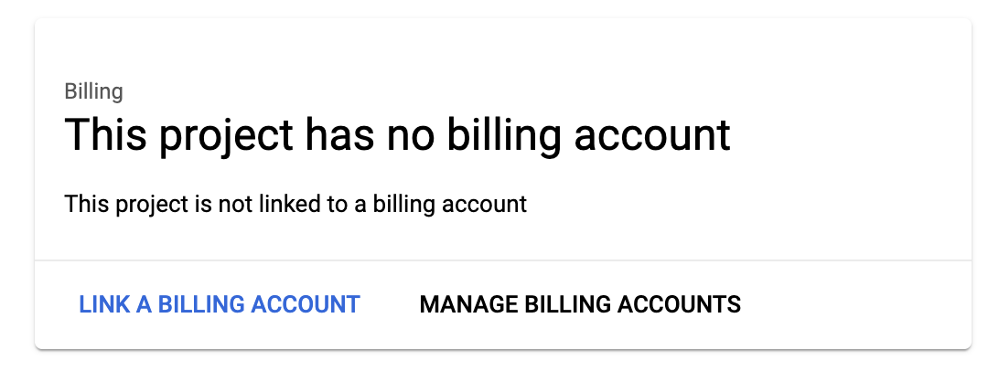
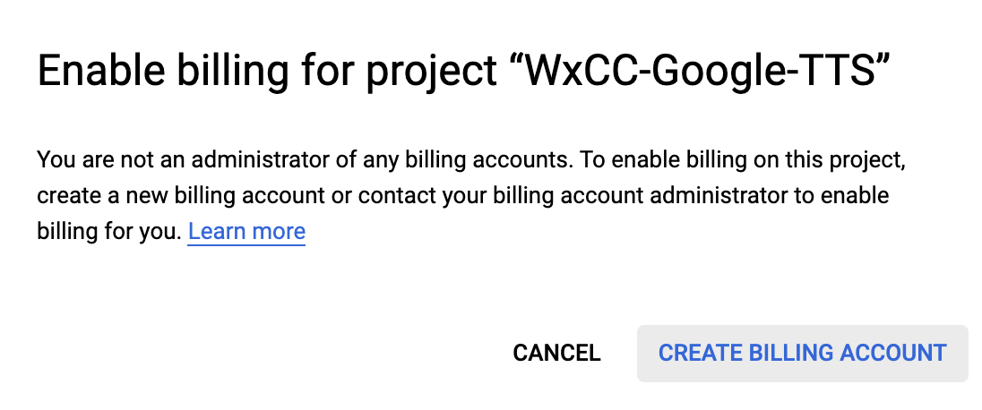
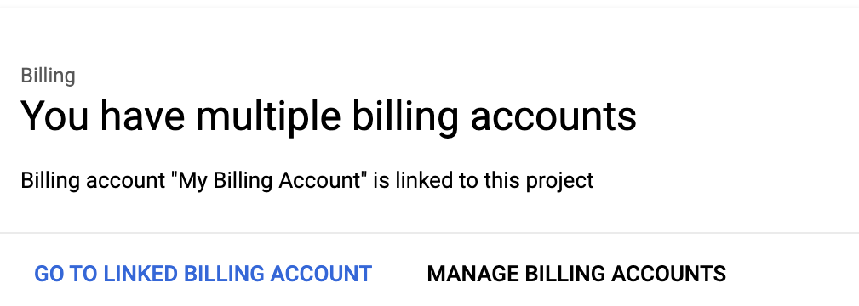
Add a Billing details (free of charge)
1
2
3

Slide 6
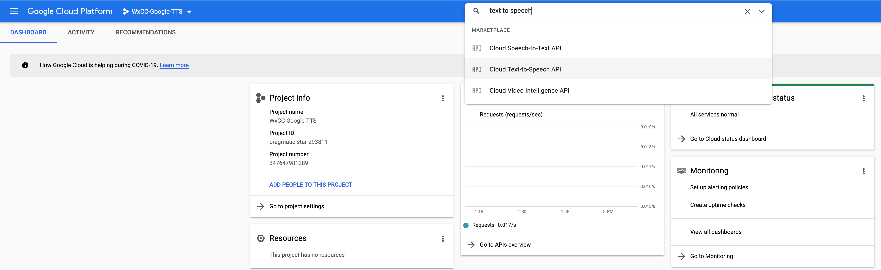
Enable Cloud TTS API
1
2

Slide 7
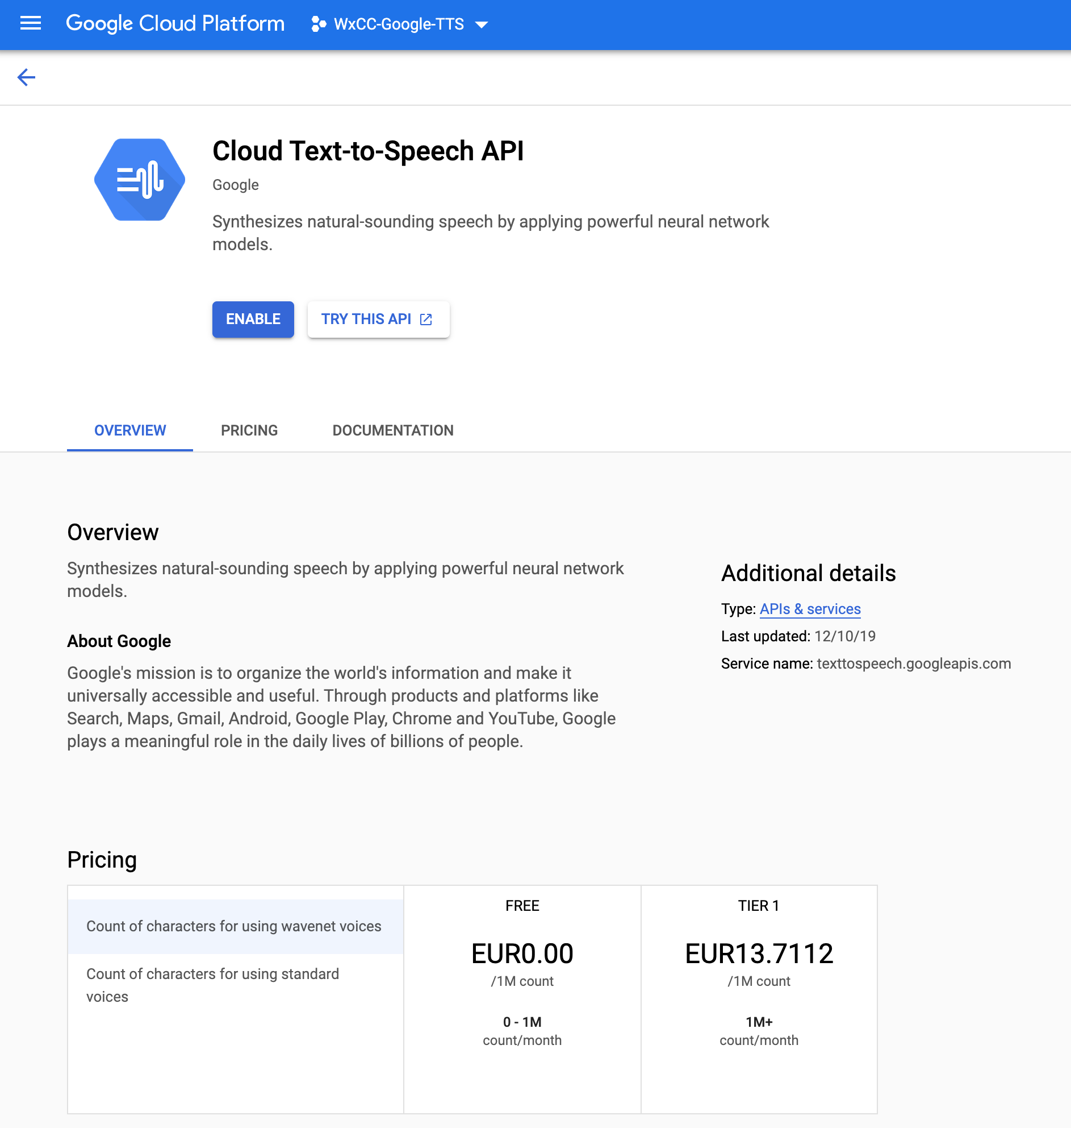
Enable Cloud TTS API

Slide 8
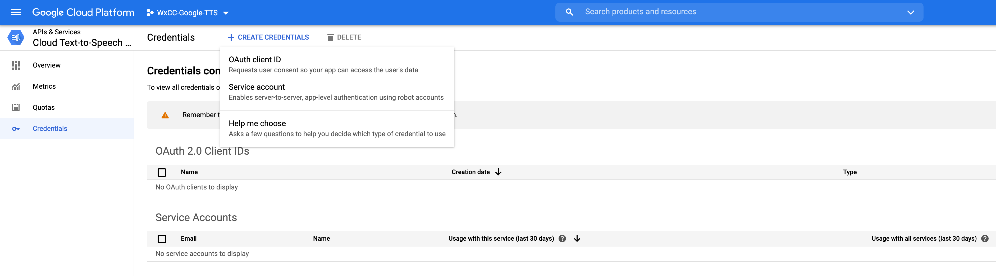
Create Private Key for Google TTS
2
3
1

Slide 9
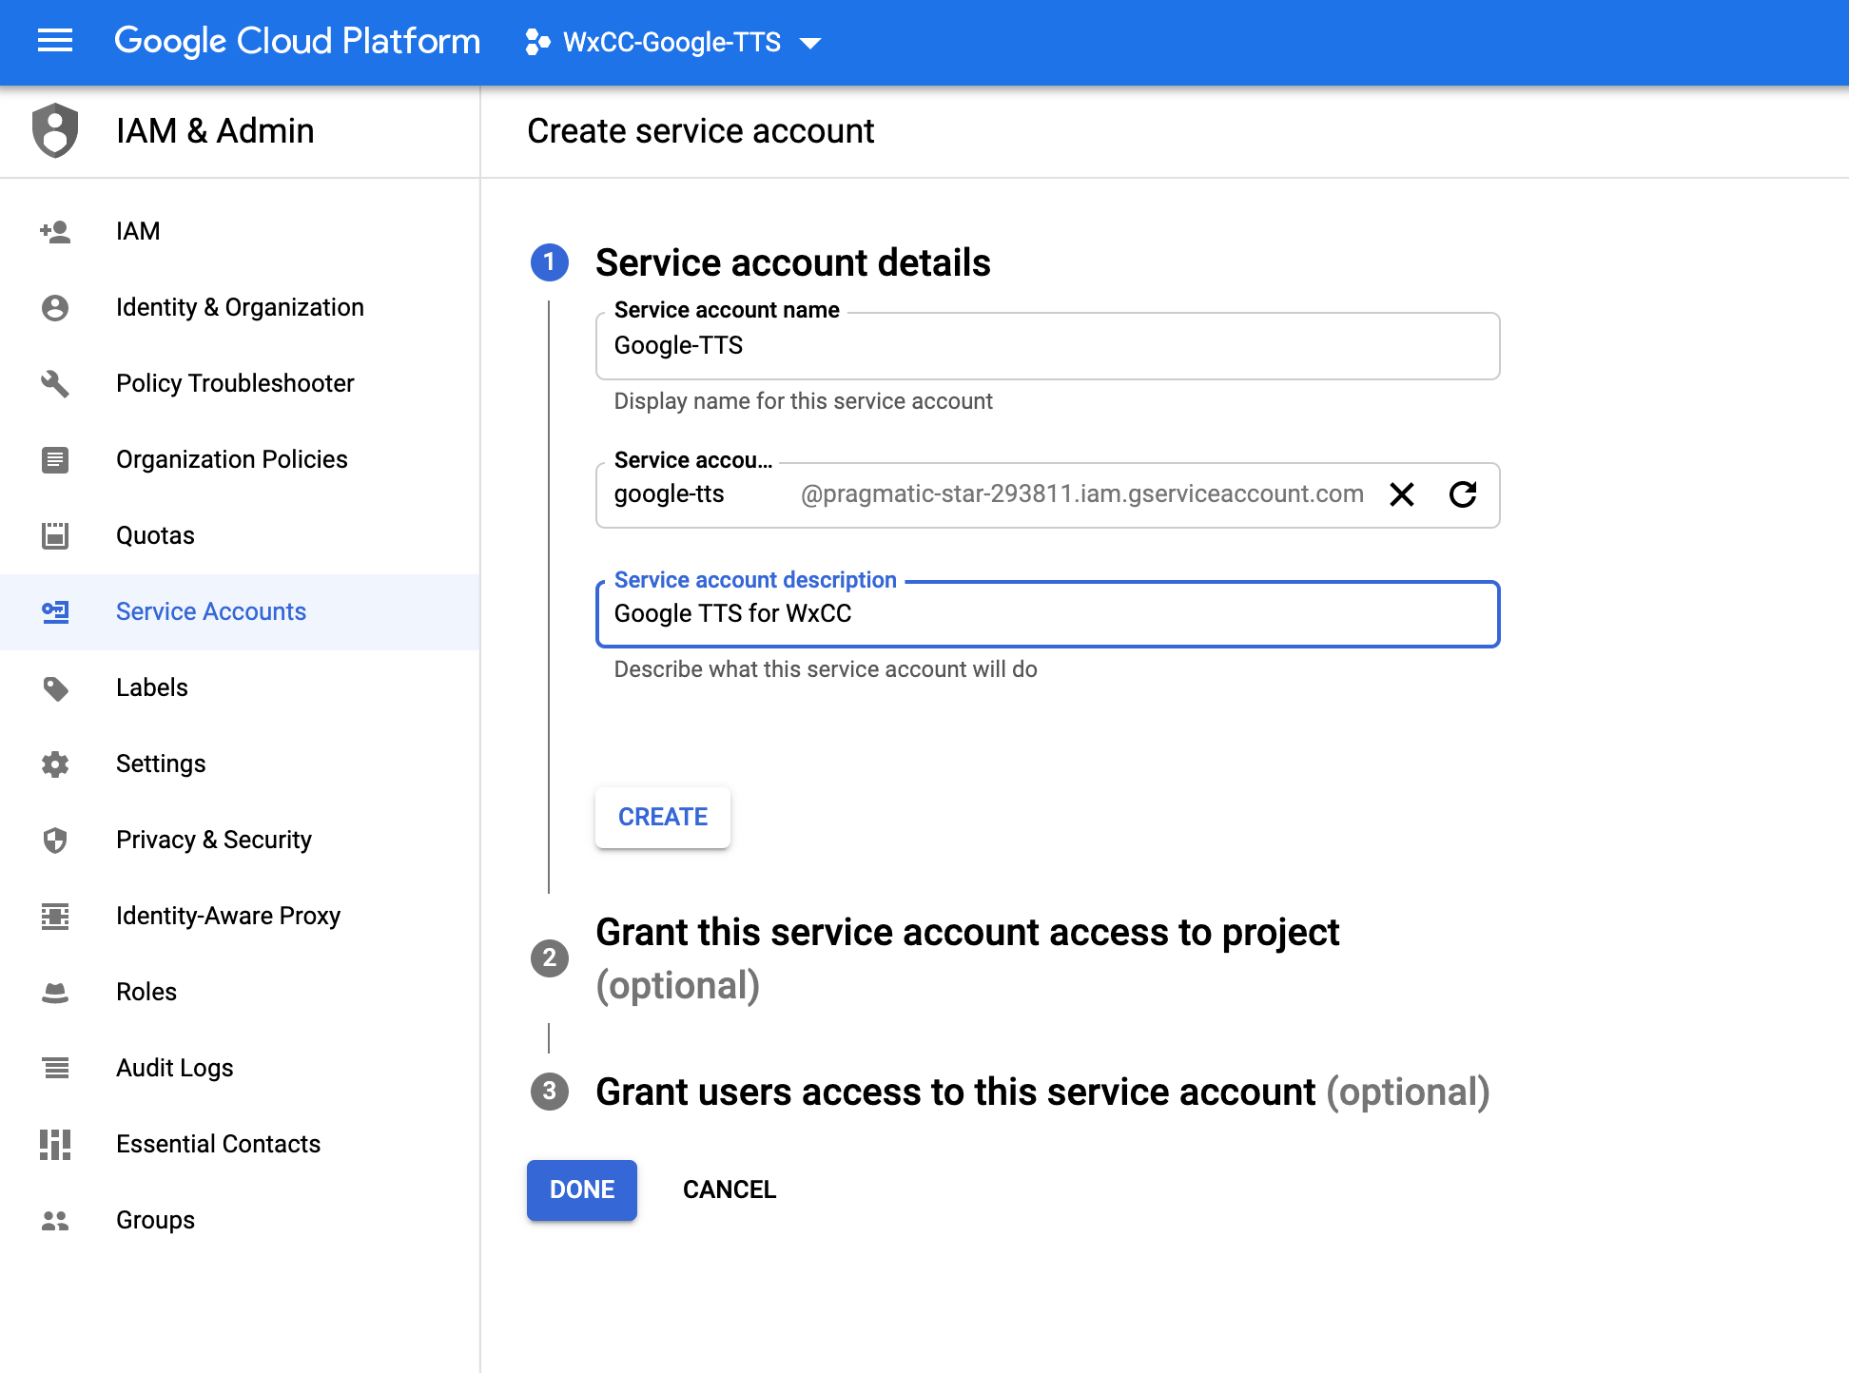
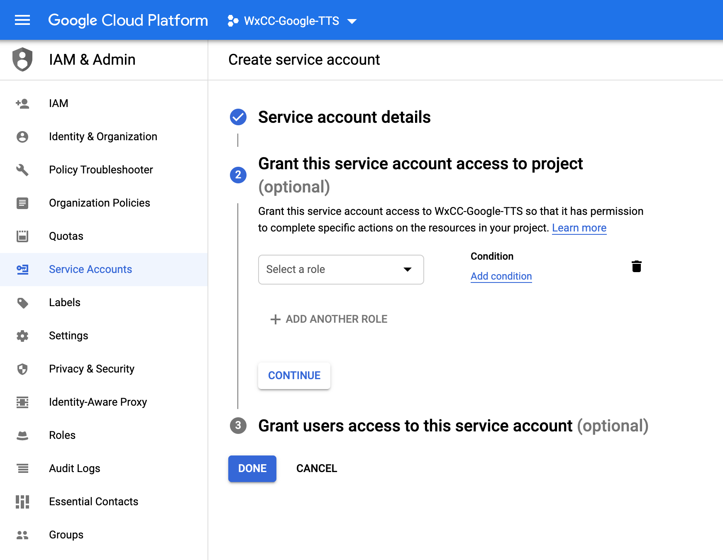
Create Private Key for Google TTS
1
2
3

Slide 10
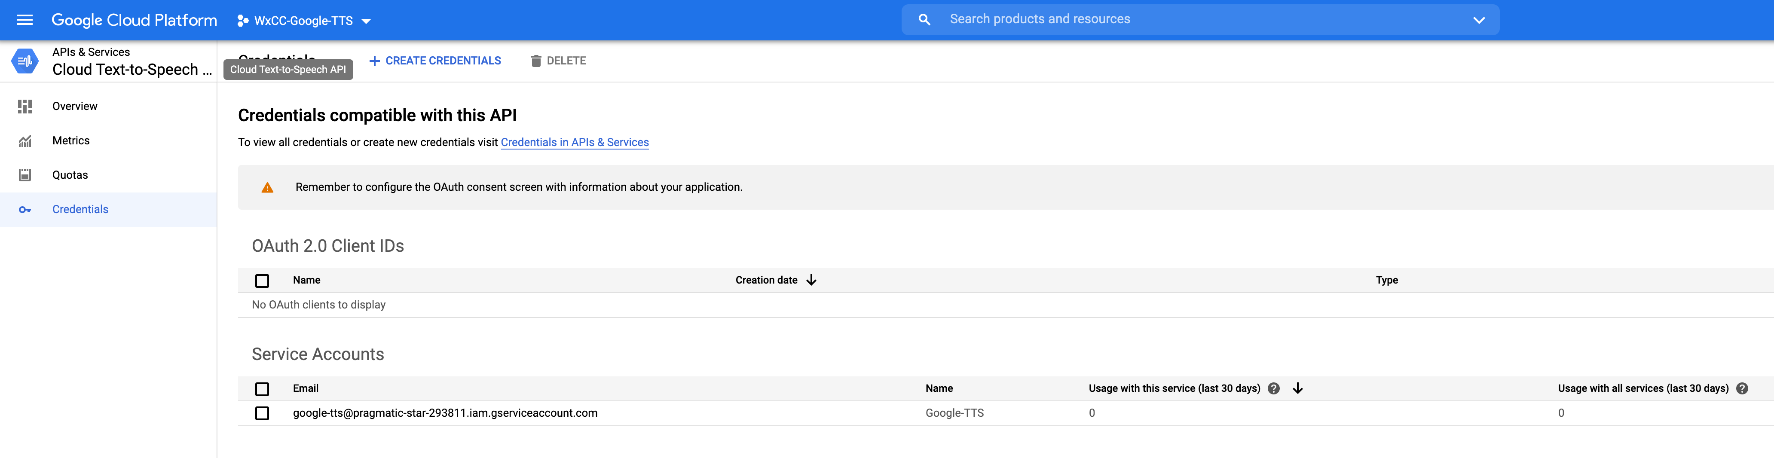
Create Private Key for Google TTS

Slide 11
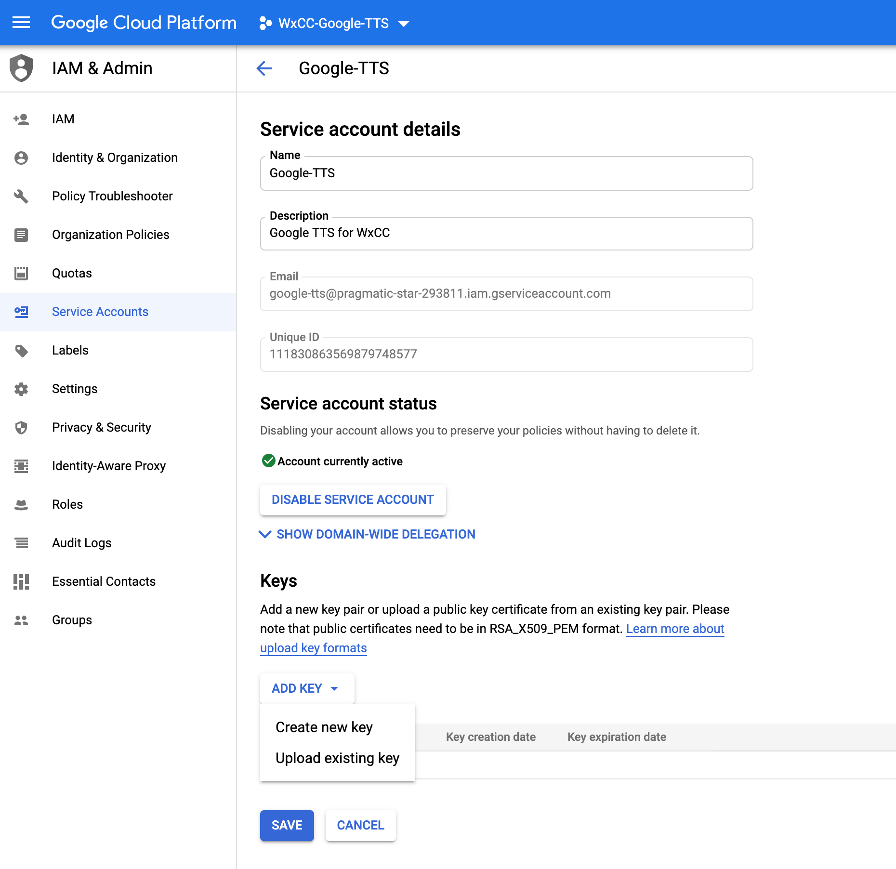
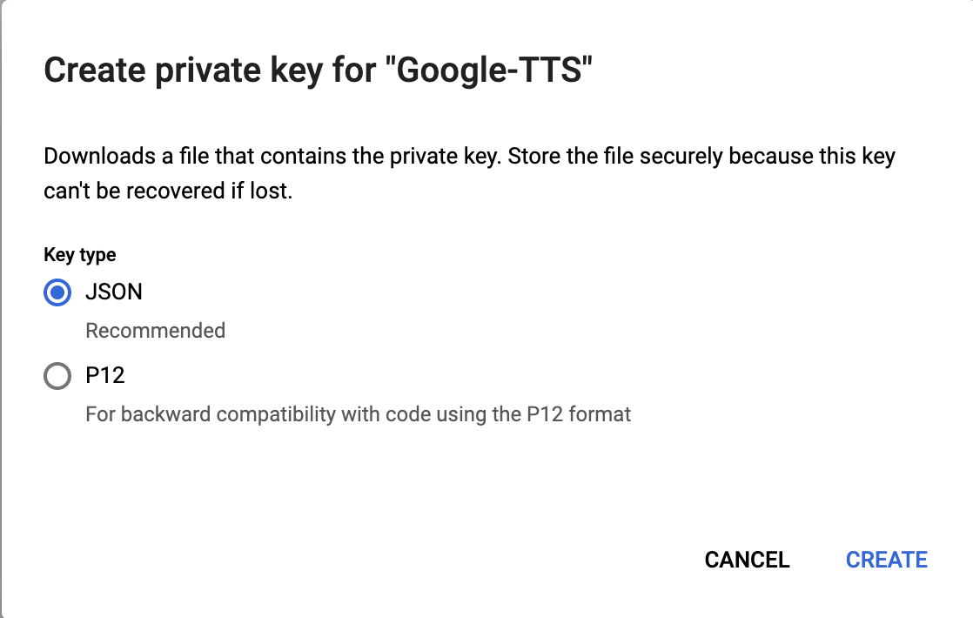
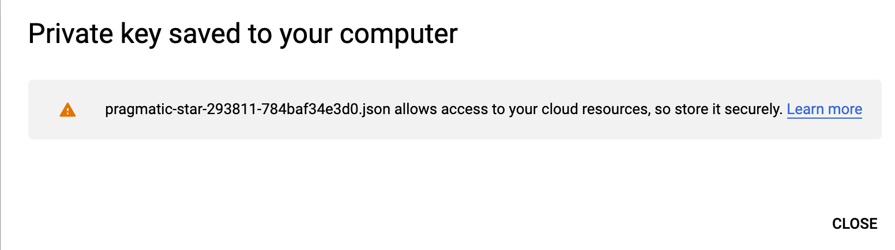
Create Private Key for Google TTS
1
4
2
3

Slide 12
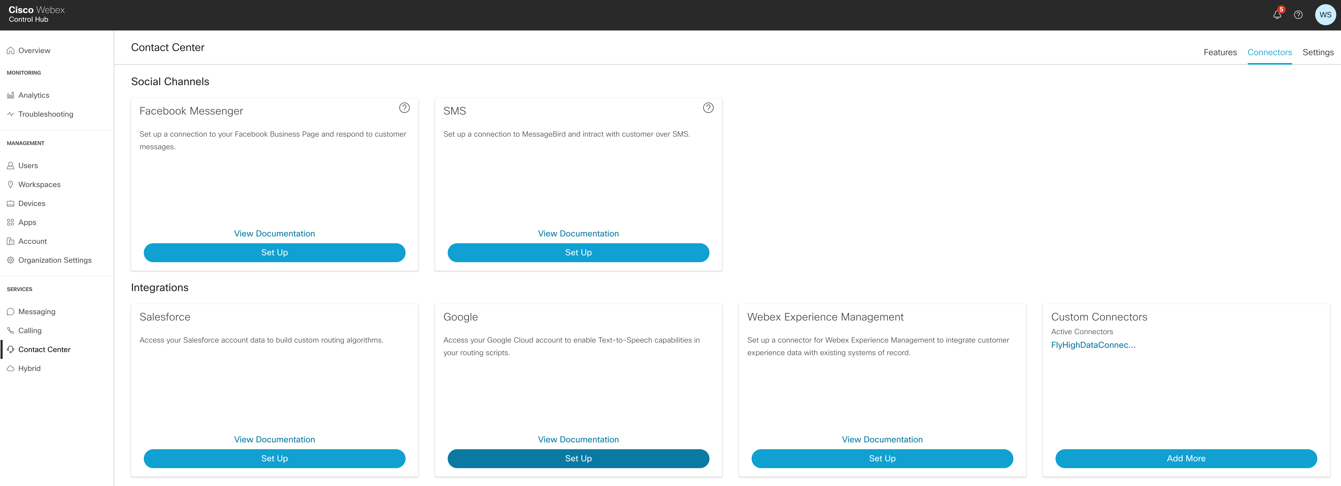
Set Up Google Connector in Control Hub
https://admin.webex.com/login

Slide 13
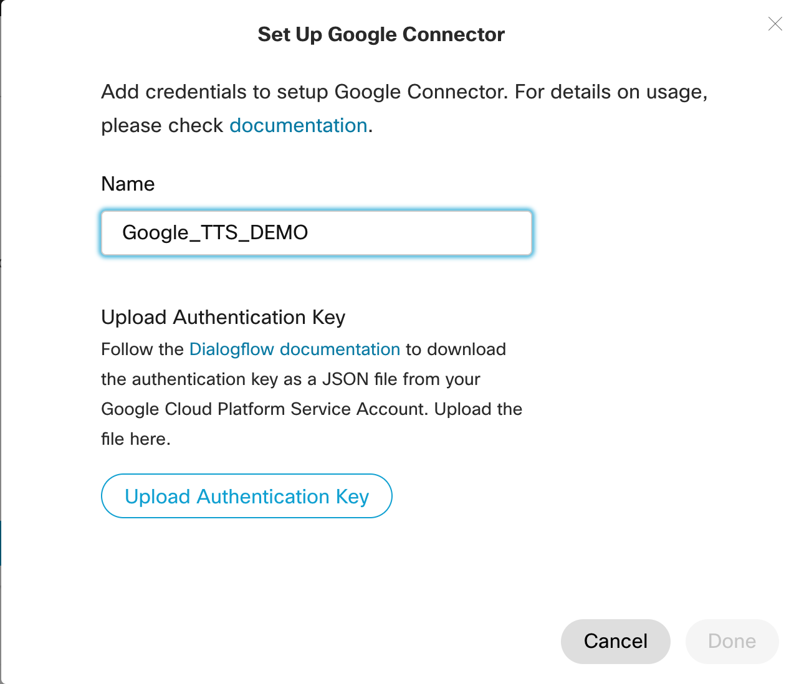
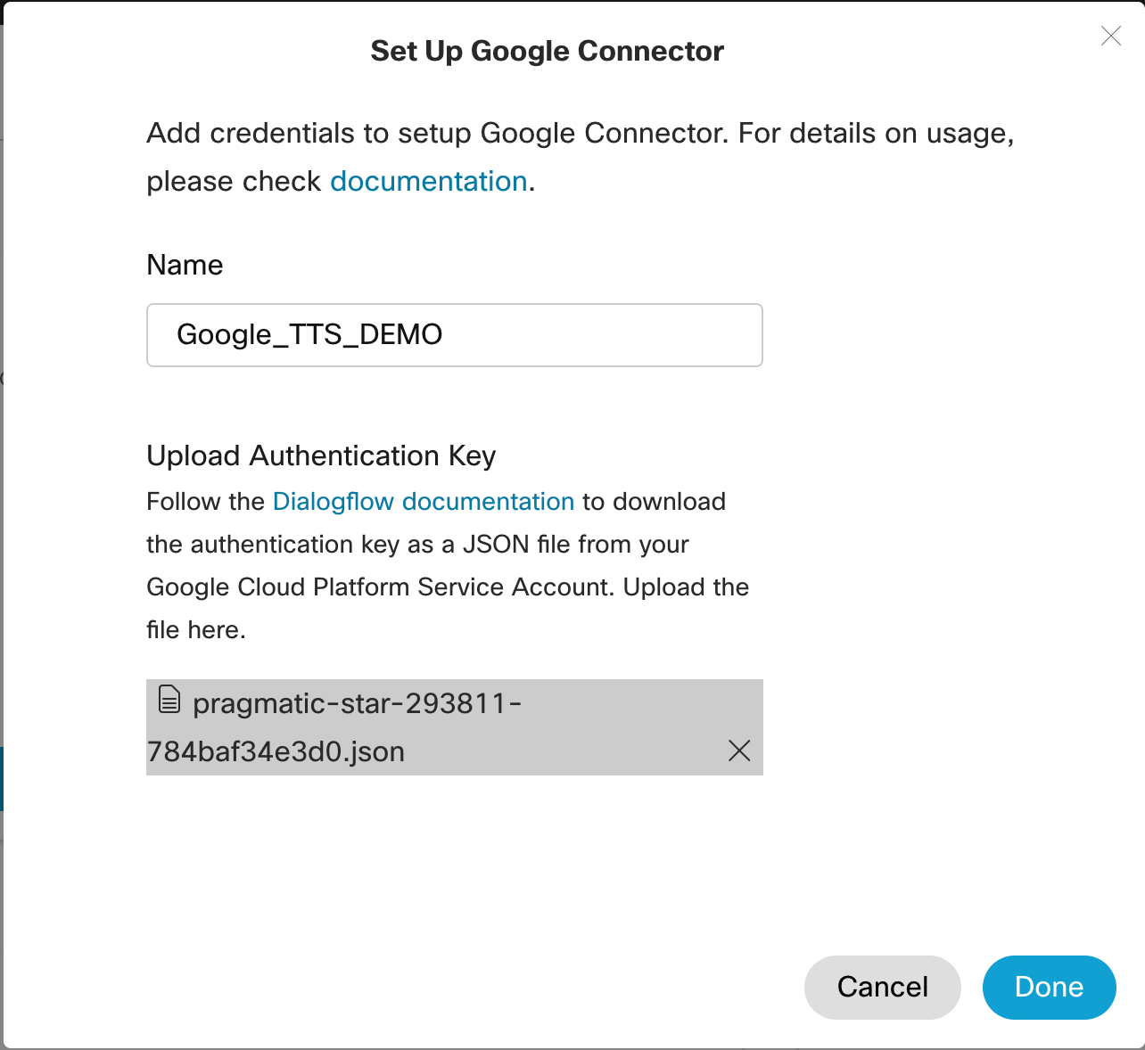
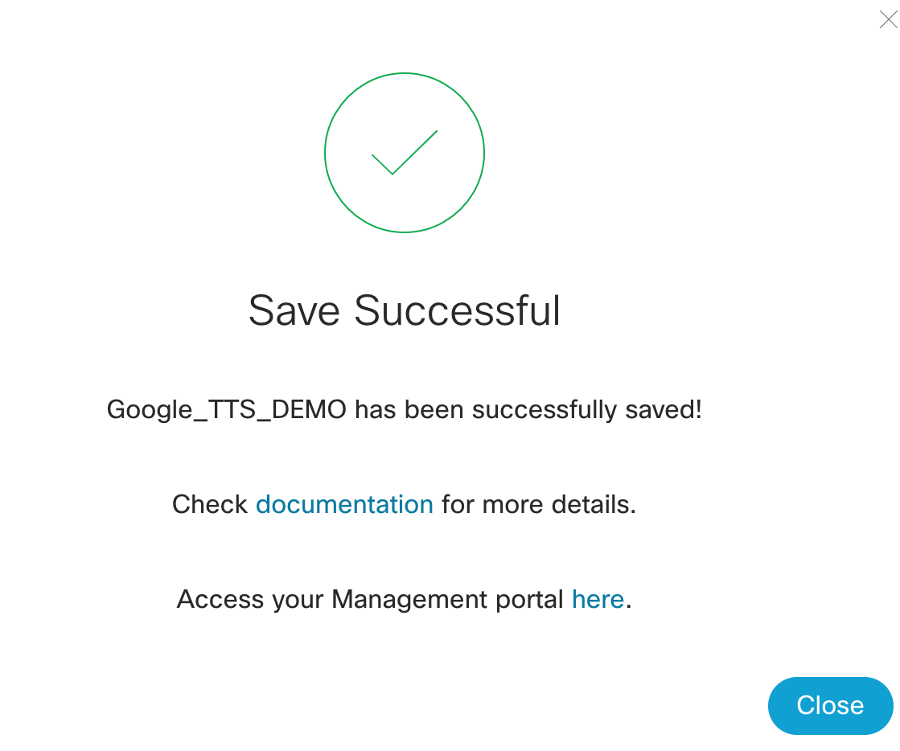
Set Up Google Connector in Control Hub
1
2
3
4

Slide 14
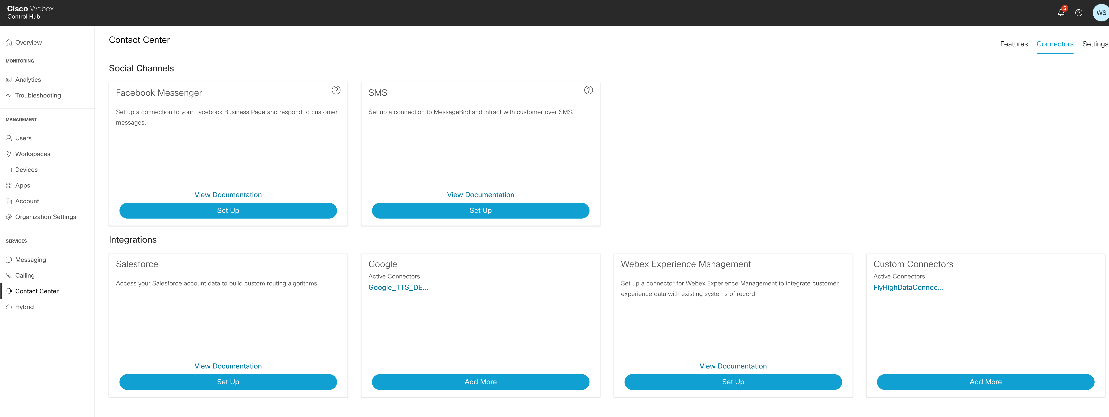
Set Up Google Connector in Control Hub

Slide 15
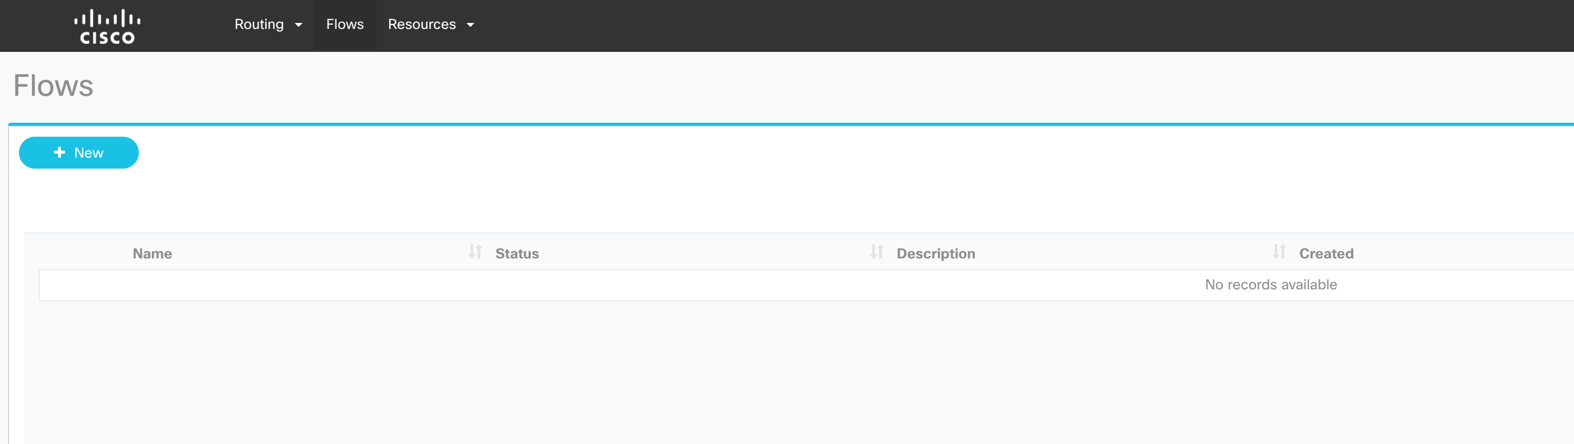
Create/Modify a Flow
https://portal.cjp.cisco.com/cdsui/rs/list
1
2

Slide 16
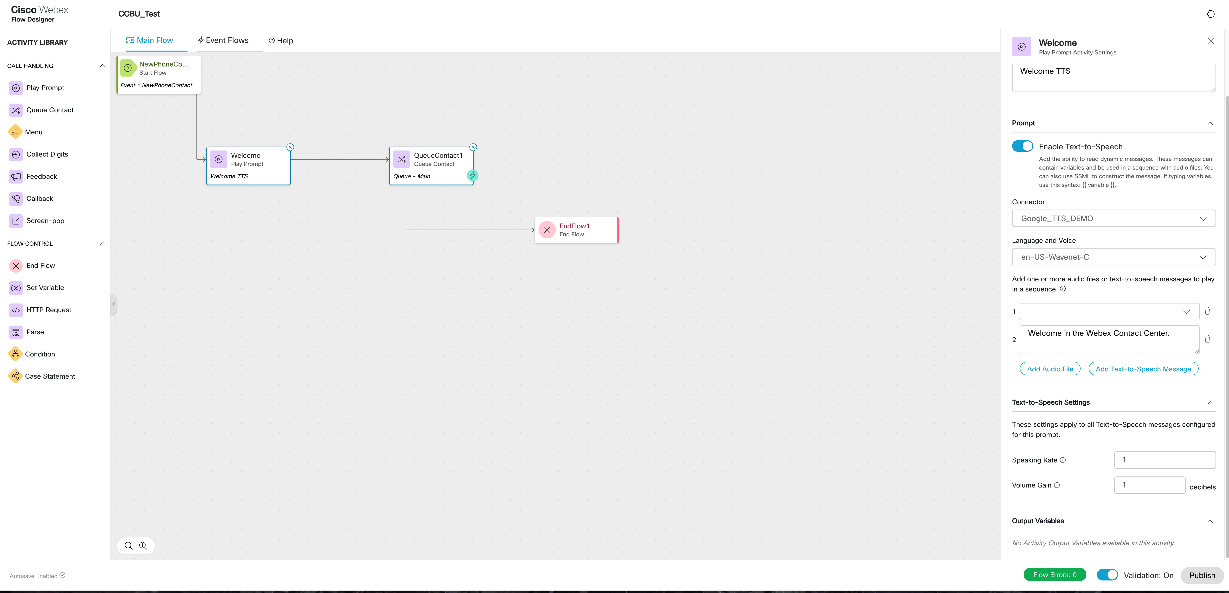
Create/Modify a Flow
2
1

